Slide 1
Python
Introduction

Slide 2
Objectives
By the end of this course, you should be able to:
Assess the importance of Python
Get started with the Python environment
Python interactive mode and scripting interface
Understand variables, constructs and indentation
List basic operations on numbers and strings
Run a python script

Slide 3
Why Should You Learn to Write Programs?
Why Should You Learn to Write Programs?
Why Should You Learn to Write Programs?
A program can be defined as a set of instructions given to a computer to achieve any objective
Notes:
Writing programs is a very creative activity. We write the programs for many purpose which helps us to automate the task.
We are surrounded in our daily lives with computers ranging from PC, laptops to cell phones. We can think of these computers as our “personal assistants” which takes care of our day to day tasks.
The hardware of computers is built in such a manner which continuously ask us the question, “What would you like me to do next". Programmer add a set of applications to the hardware and instruct the hardware to do specific task.

Slide 4
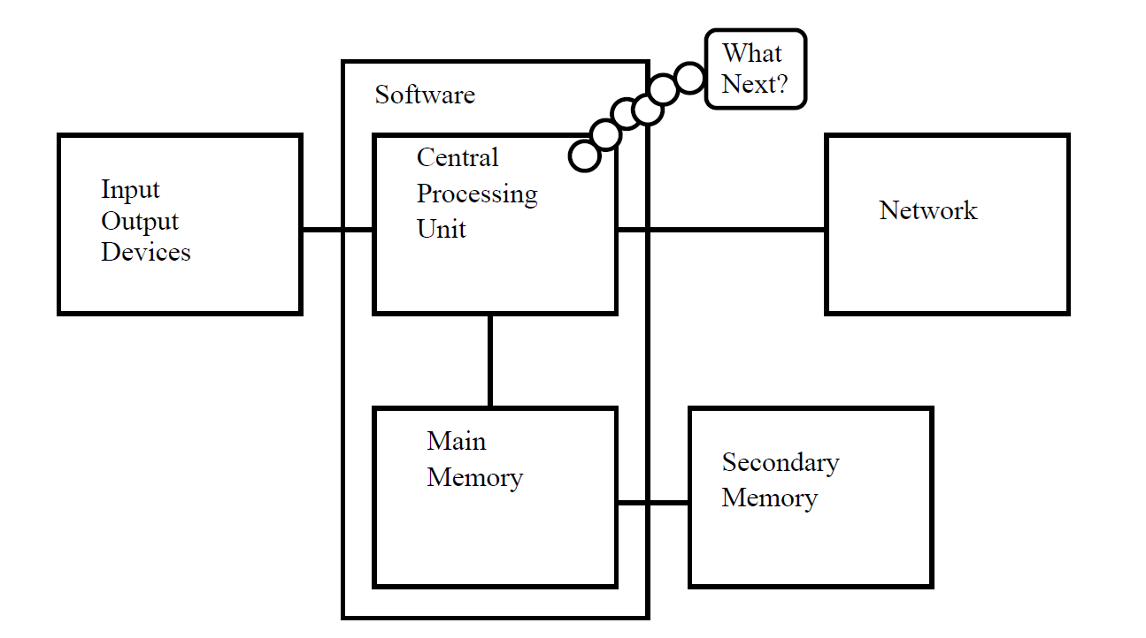
Computer Hardware Components

Slide 5

Programmer and Computer Hardware
Programmer and Computer Hardware
Programmer needs to coordinate with each of these components to solve the problem.
The data need to be analyzed to arrive at a solution.
Program will mostly be “talking” to the CPU and instructing it what to do next.
Notes:
As a programmer, our job is to use and coordinate each of these components to solve the problem and get the solution.
As a programmer we will mostly be “talking” to the CPU and telling it what to do next. Sometimes we will instruct the CPU to use the main memory, secondary memory, network, or the input/output devices.
We need to be the person who answers the CPU’s “What next?” question. So instead, we must write down our instructions in advance. We call these stored instructions a program and the act of writing these instructions is programming.

Slide 6
Skills Required for Programming Programming
There are two important skills required for programming.
Knowledge of the programming language
The vocabulary and the grammar of the language.
Construct well formed “sentences” in the new language.
Ability to “Tell a Story”
In writing a story, words and sentences need to be combined to convey required logic to the computer.
There is a skill and art in constructing the story and skill in story writing is improved by doing some writing and getting some feedback.
Notes:
We will try to turn you into a person who is skilled in programming. At the end you will be a programmer with the skills to look at any data/information and develop a program to solve the problem.
We need two skills to be a programmer.
First, we need to know the programming language Python. We need to know the vocabulary and the grammar. We need to be able to spell the words in this new language properly and know how to construct well formed “sentences” in this new language.
Second, we need to “tell a story”. In writing a story, we combine words and sentences to convey an idea to the reader. There is a skill and art in constructing the story. In programming, our program is the story and the problem we are trying to solve is the idea.
We will learn the vocabulary and sentences of Python quickly. It will take longer for us to be able to write coherent program to solve a new problem. First we write simple program then slowly we will write complex program over time.

Slide 7
Programming language - History
1951 – Regional Assembly Language
1952 – Autocode
1954 – IPL (forerunner to LISP)
1955 – FLOW-MATIC (led to COBOL)
1957 – FORTRAN (First compiler)
1957 – COMTRAN (precursor to COBOL)
1958 – LISP
1958 – ALGOL 58
1959 – FACT (forerunner to COBOL)
1959 – COBOL
1959 – RPG
1962 – APL
1962 – Simula
1962 – SNOBOL
1963 – CPL (forerunner to C)
1964 – Speakeasy (computational environment)
1964 – BASIC
1964 – PL/I
1966 – JOSS
1967 – BCPL (forerunner to C)

Slide 8
Programming language – History-2
1968 – Logo
1969 – B (forerunner to C)
1970 – Pascal
1970 – Forth
1972 – C
1972 – Smalltalk
1972 – Prolog
1973 – ML
1975 – Scheme
1978 – SQL (a query language, later extended)
1980 – C++ (as C with classes, renamed in 1983)
1983 – Ada
1984 – Common Lisp
1984 – MATLAB
1985 – Eiffel
1986 – Objective-C
1986 – LabVIEW (Visual Programming Language)
1986 – Erlang
1987 – Perl
1988 – Tcl
1988 – Wolfram Language (as part of Mathematica, only got a separate name in June 2013)

Slide 9
Programming language – History-3
1989 – FL (Backus)
1990 – Haskell
1991 – Python
1991 – Visual Basic
1993 – Ruby
1993 – Lua
1993 – R
1994 – CLOS (part of ANSI Common Lisp)
1995 – Ada 95
1995 – Java
1995 – Delphi (Object Pascal)
1995 – JavaScript
1995 – PHP
1997 – Rebol
1999 – D
2000 – ActionScript
2001 – C#
2003 – Apache Groovy
2003 – Scala
2005 – F#
2006 – Windows PowerShell
2007 – Clojure
2009 – Go
2010 – Rust
2011 – Dart
2011 – Kotlin
2012 – Julia
2014 – Swift

Slide 10
Interpreted language
Compiled language
C
C++
Objective-C
Swift
D
C# (to bytecode)
Java (to bytecode)
JavaScript
Python
Ruby
Forth

Slide 11
What is Python?
A very high level, object-oriented language
Easy to read and program with
Similar to Perl but with powerful typing and object-oriented features
Scripting Language

Slide 12
Key Features
Python focusses on readability, coherence, simplicity
Python code is usually very compact
Python code is portable across OS platforms
Huge collection of libraries available for use by developers

Slide 13
About Python
Invented in the Netherlands in the early ‘90s by Guido van Rossum.
Name after ‘Monty Python’, a comedy group, depicting its ‘fun’ philosophy
Open source and interpreted language
Considered a ‘scripting’ language, but is much more than that
Scalable, object-oriented and functional
Used by Google, increasingly popular
Python knowledge is on high trending currently

Slide 14
Users of Python
YouTube: Originally written in Python and mysql
Yahoo!: Yahoo acquired Four11, whose address and mapping lookup services are implemented in Python
Yahoo! Maps uses Python
DropBox, a cloud based file hosting service runs on Python
Google: Many components of the Google spider and search engine are written in Python

Slide 15
Traditional Uses of Python
Embedded Scripting
Image processing
Artificial intelligence
GUI’s
Database Programming
Internet Scripting
System Administration
Automation

Slide 16
Uses of Python in Data Analytics
Weather Forecasting
Scientific analysis
Ad targetting
Risk Management Analysis
Natural Language Processing and Generation

Slide 17
Python 2 or Python 3?
We would be using Python 3.5+
Library support is more for Python 2.7 as it has been around longer
The future is going to be Python 3+
Development and porting of libraries is an ongoing process
There are several key syntactic changes so advisable to be with 3.5+

Slide 18
How to get Python?
Comes pre-installed on most Unix systems, including Linux and Mac OS X
Check your python version by issuing the following command
python --version
Python 3.5.2

Slide 19
Python Download and Installation
Python may be downloaded from the following URL
https://www.python.org/downloads/
You can choose the version and operating system
Version 3.4 onwards is recommended

Slide 20
Using Python
Python can be used in interactive or scripting mode
Interactive mode allows one to quickly interact with Python on a command line interface
Scripting mode allows to store several commands and constructs to be saved as a program and then executed at one go
Demonstration of both of these modes follows:

Slide 21
Comments , Literals, Variables
Any statement with a leading ‘#’ is treated as a comment
Literal Constants : Any number or a string value
Variable : A user defined container that can hold a literal value
a=10 # variable a contains 10
b=‘Hello’ # Storing a string ‘Hello’ in variable b
c=“World” # Stores a string ‘World’ in variable c
Variable : A user defined container that can hold a literal value

Slide 22
Python identifiers
Identifiers are names for entities
variables
functions
classes
objects
Identifiers have the following rules
Starts with [a-zA-Z_]
Following character could also include digits [0-9]
case-sensitive: Hello, hello and HELLO are three separate identifiers
Only special character allowed is the underscore ( _ )

Slide 23
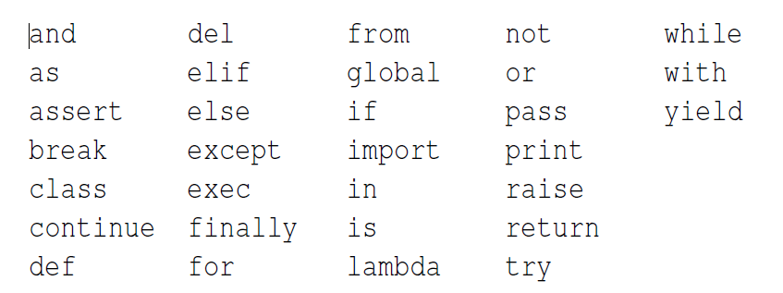
Words and Sentences
Reserved words in Python
Notes:
We will learn these reserved words and how they are used in forth coming session. We will now focus on Python language only. Our sentence starts with reserved word print followed by a string of text of our choosing enclosed in a single quotes.
A simple example of Python message
print ("Hello World")

Slide 24
Variables and Constants
Fixed values used in programs such as numbers, letters, and strings are called as constants.
Values of constants never change during program execution.
Variables are named memory location used to store data in program which keeps on changing during execution. Programmers can decide the names of the variables.
Example for Constant
>>> print (123)
123
>>> print (98.6)
98.6
>>> print ('Hello world‘)
Hello world
Example for Variable
x = 12.2
y = 14
Later:
x = 78
y = 98
Notes:
Fixed values used in programs such as numbers, letters, and strings are called as constants.
Values of constants never change during program execution.
A variable is a named place in the memory where a programmer can store data and later retrieve the data using the variable “name”
Programmers get to choose the names of the variables
You can change the contents of a variable in a later statement

Slide 25
Variables and Constants (Contd.)
Variables and Constants
Variable naming conventions
Must start with a letter or an underscore “_”.
Must consist of letters, numbers and underscores.
Case Sensitive.
Example :
First_name
Age
Num1
testnum
You can not use reserved words for variable names and identifiers.
Notes:
Examples of Variable naming conventions:
Valid: first_name , age, num, _speed.
Invalid: 23spam , #sign, var.12.
Different: spam, Spam, SPAM.

Slide 26
Variables and Constants (Contd.)
Variables and Constants
Mnemonic variable names :
Use simple rules of variable naming and avoid reserved words.
While using simple rules we have lot of choice for variable naming.
Initially this choice can be confusing either in reading or writing the program.
For example, the following two programs are identical in terms of what they accomplish, but very different when you read and try to understand them.
Example 1:
a = 35.0
b = 12.50
c = a * b
print c
Example 2:
hours = 35.0
rate = 12.50
pay = hours * rate
print pay
Notes:
The Python interpreter understand the above mentioned programs exactly the same but humans see and understand these programs quite differently.
Humans will most quickly understand the intent of the second program because the programmer has chosen variable names that reflect their intent regarding what data will be stored in each variable. We call these wisely chosen variable names “mnemonic variable names”.

Slide 27
Programming Statements
Programming Statements
x = 2 ← Assignment Statement
x = x + 2 ← Assignment with expression
print x ← Print statement
Various components of programming statements
Variable
Operator
Constant
Reserved Word
Notes:
Sentences or Lines used in program are called as programming statements
We assign a value to a variable using the assignment statement (=).
An assignment statement consists of an expression on the right hand side and a variable to store the result.
Example :
x = 3.9 * x * ( 1 - x )

Slide 28
cProgramming Statements
edence
Operators are used to manipulate the values of operands.
There are various types of Operators used in program :
Arithmetic operators.
Comparison (relational) operators.
Assignment operators.
Logical operators.
Notes:
Operators are used to manipulate the values of operands.
Example :
Consider the expression 7 + 5 = 12. Here, 7 and 5 are called operands and + is called operator.
Python supports various operators which are classified below:
Arithmetic Operators.
Comparison (Relational) Operators.
Assignment Operators.
Logical Operators.

Slide 29
Operators and Its Precedence (Contd.)
Arithmetic Operators
Arithmetic Operators :
Arithmetic operators are the symbols that are used to perform arithmetic operations on operands.
Types of Arithmetic operators:
Operator | Meaning
+ | Addition
- | Subtraction
* | Multiplication
/ | Division
% | Modulus
Notes:
Arithmetic operators :
Arithmetic operators are used to perform mathematical operations like addition, subtraction, multiplication etc.

Slide 30
Comparison Operators Contd.)
Comparison Operators :
These operators compare the values of an operands and decide the relation among them. They are also called Relational operators.
Types of Comparison Operators:
Operator | Meaning
< | Less than
<= | Less than or Equal
== | Equal to
>= | Greater than or Equal
> | Greater than
!= | Not equal
Note:
“=” is used for assignment.
Notes:
Comparison operators : Comparison operators are used to compare values. It either returns True or False according to the condition.
Boolean expressions using comparison operators evaluate to - True / False - Yes / No.

Slide 31
Logical Operators Precedence (Contd.)
Logical Operators :
Logical operators are used to evaluate expressions and return a Boolean value.
Types of Logical Operators :
Operator | Meaning
x and y | Returns True if x and y are True, False otherwise
x or y | Returns y if either x or y is True, False otherwise
not x | Returns True if x is False, False otherwise
Notes:
Logical Operators :
There are three logical operators supported by Python language and, or , not.
if condition1 and condition2:
action1
# if both condition1 and condition2 are true, execute action1
if condition1 or condition2:
action2
# if either condition1 or condition2 is true, execute action2
Example:
>>> x = 2; y = 3; L = [0,1,2]
>>> if (1<x<=3 and 4>y>=2) or (1==1 or 0!=1) or 1 in L:
... print 'Hello world'
...
Hello world
>>>

Slide 32
Operators and Its Precedence
Operator precedence - When we use multiple operators in an expression program must know which operator to execute first, This is called as “operator precedence”.
For Example in following expression multiple operators but they will execute as per precedence rule:
x = 1 + 2 * 3 - 4 / 5 ** 6
Notes:
Operator precedence decides on how an expression is evaluated during program execution.

Slide 33
Operators and Its Precedence (Contd.)
Highest precedence rule to lowest precedence rule
Parenthesis are always respected hence given first priority.
Exponentiation (raise to a power).
Multiplication, Division, and Remainder.
Addition and Subtraction.
Left to right.
Parenthesis
Power
Multiplication
Addition
Left to Right
Notes:
Associativity
Associativity is the order in which an expression is evaluated that has multiple operator of the same precedence. Almost all the operators have left-to-right associativity.

Slide 34
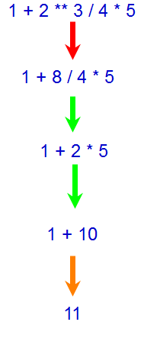
Operators and Its Precedence (Contd.)
>>> x = 1 + 2 ** 3 / 4 * 5
>>> print x
11
Parenthesis
Power
Multiplication
Addition
Left to Right

Slide 35
The following table lists all operators from highest precedence to lowest.
Operator | Description
** | Exponentiation (raise to the power)
~ + - | Complement, unary plus and minus (method names for the last two are +@ and -@)
* / % // | Multiply, divide, modulo and floor division
+ - | Addition and subtraction
>> << | Right and left bitwise shift
& | Bitwise 'AND'
^ | | Bitwise exclusive `OR' and regular `OR'
<= < > >= | Comparison operators
<> == != | Equality operators
= %= /= //= -= += *= **= | Assignment operators
is is not | Identity operators
in not in | Membership operators
not or and | Logical operators

Slide 36
Activity
Activity : Understanding Operators
Problem Statement:
Write a program which prompts the user for a Celsius temperature, convert the temperature to Fahrenheit, and print out the converted temperature.
Hint: Use the following formula:
F=C*9/5+32
Here, C is the temperature in Celsius and F is the temperature in Fahrenheit.
Notes:
Solution:
In order to do this activity, you need to perform the following tasks:
Create a Python empty project.
Use F=C*9/5+32, to calculate the temperature in Fahrenheit.
Task 1: Create a Python empty project:
Step 1: Open NetBeans 8.0.2.
Step 2: Click File menu.
Step 3: Select New Project.
Step 4: Select Python from Categories list and Python Project from Projects list.
Step 5: Click Next button.
Step 6: On New Python Project dialog box set the Project Name as CR_Session02_Exercise02.
Step 7: Select project Location by clicking Browse button.
Step 8: Click Finish button.
Task 2: Use F=C*9/5+32, to calculate the temperature in Fahrenheit:
Step 1: Type the following code:
inp = raw_input('Enter Celsius Temperature: ')
cel = float(inp)
fahr = ( cel * 9.0 ) / 5.0 + 32.0
print(fahr)
Step 2: Run the program.

Slide 37
Strings - Basics
Strings are ordered blocks of text
Written inside quotes ( both single and double quotes can be used )
Basic Operations with strings
Concatenation: ‘hello’ + ‘world’ will result in ‘helloworld’
Repetition: ‘hello’ * 3 = ‘hellohellohello’
Indexing
Indexes start at 0
s[i] fetches character at index i

Slide 38
Some builtin string methods
.capitalize()
python -> Python
.count(str, begin=0, end=len(str))
Count number of occurrences of substring str inside this string
.find(str, begin=0, end=len(str))
Find first occurrence of str in string

Slide 39
Demonstration
Using string operations and methods in interactive interface
concatenation
repetition
find
count

Slide 40
Indentation & Blocks
Indentation
Leading whitespace to shift some line starts to the right of others
Is used to determine grouping of statement in Python
Defines a ‘statement block’
Blocks
Start with a statement ending with ‘:’
All lines following it are indented forward
De-indenting to the previous level closes the block
Some editors, IDE’s automatically take care of indentation
Repeat: there are no curly braces { } in python for defining blocks

Slide 41
Basic constructs
Conditions
if condition: statement
if condition: block
else
elif
Loops
for
while
break
continue

Slide 42
Constructs : Conditionals
if <condition>: statement or a block
if a<10 : print(“a is less than 10”)
if b<a :
print(“less”)
print(“value of a is “,a)
print(“value of b is “,b)

Slide 43
Constructs : Conditionals
if a<10 : print(“a is less than 10”)
else: print(“a is not less than 10”)
if b<a :
print(“less”)
print(“value of a is “,a)
print(“value of b is “,b)
else:
print(“Was not less”)

Slide 44
Constructs : Conditionals
if a<10:
print(“hello”)
elif a<5:
print(“world”)

Slide 45
Constructs : Conditionals
A ternary usage of if statement
print(“hello”) if a<10 else print(“world”)

Slide 46
Constructs : Conditionals
Keywords related to conditional statements
if
else
elif

Slide 47
Constructs : Iterations
while <condition>:
block
All the statements of the block are executed if the condition is true
At end of the block the condition is re-evaluated
If condition is still true, then the block is repeated

Slide 48
Constructs : Iterations
a=0
while a<10:
print(a)
a=a+1
This would display number 0 to 9

Slide 49
Constructs : Iterations
for <variable> in <iterable>:
block
The for loop iterates over an iterable, assigning subsequence elements of the sequence to the variable and then executing the block
ctr=0
for x in “hello world”: # String is an iterable sequence of characters
if x == “o” : ctr=ctr+1
print(ctr)

Slide 50
Constructs : Iterations
for x in range(10):
print(x)
range function generate a sequence of number 0 to 9

Slide 51
Constructs : Iterations
range(10) # generates 0 to 9
range(3,10) # generates 3,4,5,6,7,8,9
So range function does not include the upper limiting value
range(3,10,2) # The third parameter is the stride or increment
# default stride was 1
# 3, 5 , 7 , 9

Slide 52
Constructs : Iterations
break statement terminates a loop
continue statement re-evaluates condition and restarts the block if true
else block in loops gets executed if the loop never got started
a=10
while a<10:
print(“a)
a=a+1
else:
print(“while loop never got started”)

Slide 53
Taking input from the keyboard
x=input()
x=input(“Enter a value”)
Value entered would be read as a string.
If we want it to be used as a number we can convert it
x=input(“Enter a value”)
y=int(x) # converts to integer
or
x=int(input(“Enter a value”)) # gets a number into x

Slide 54
Getting down to programming
Writing a python script
Executing a python script
Debugging
Displaying results – the print function
print(a)
print(“This is the result”,a)
print(a,b,c)

Slide 55
Running a python script
Python code saved in file with .py extension
On a shell prompt type: python myfile.py
Edit, save, run, repeat

Slide 56
Sample programs to try
Count digits in a number
Find out how many times a particular digit occurs in a number
Display the Fibonacci series up to a max limit
Display first n numbers of a Fibonacci series
Calculate the factorial of a number n
A program that generates all prime numbers between x and y

Slide 57
Lab Exercises
Generate the first 10 even numbers
Input a number and check if it is prime or not
Input 10 numbers and display the smallest and largest of them
Input 10 numbers and display the sum and average.
Explore the internet and find out how to display a floating number to required decimal places.
Input a number and calculate its factorial
Additionally try out the questions discussed in the lecture session as
same or alternative methods.

